Slide 1
Improving efficiency of Venturi Scrubber by Analysis of Efficiency contributing parameters for Sustainable Development
Guided By
Prof. Shital Patel
Presented By
Ms.Priyanka P. Khutwal

Slide 2
Contains
Introduction
Objective
Problem statement
Literature survey
Methodology
References

Slide 3
Introduction
Sustainable development is development that meets the needs of the present without compromising the ability of future generations to meet their own needs
The overall air problem basically includes the forms such as , emissions, transport, dilution, and modification in the atmosphere, which effects on people, property, and the environment.
We are unlikely to find a good and easy way to solve all these problems.
Doing some research on particulate removal from gaseous waste streams so that improve the air quality.

Slide 4
Cont..
So many method are available for the pollution monitoring for the industry like, separation techniques, gas solid separation, liquid-liquid separation, gas liquid separation.
In case of gas solid separation technique cyclone separator, multi clone, electrostatic precipitator, scrubber and fabric filter including ceramic filter pollution monitoring equipment are used

Slide 5
Cont..
Among all techniques gas solid separator and the equipment venturi scrubber is the best one.
The venturi scrubber is a device which uses liquid in the form of droplets to efficiently remove fine particulate matter from gaseous streams

Slide 6
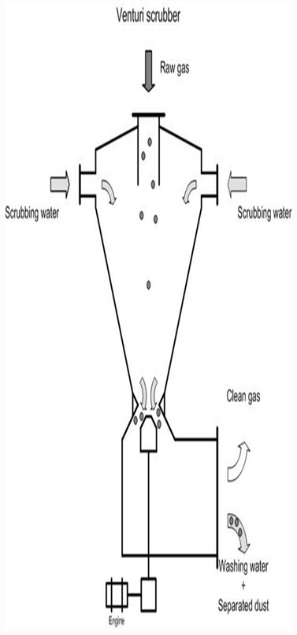
Cont..
A venturi scrubber consists of a converging section, a throat (the narrowest part of the venture tube) and a diffuser.
The dust/gas mix flows through the venturi tube and reaches top speed in the throat section.
Thereafter, the mixture passes into the diffuser where the speed drops again.
Liquid is added to the gas flow either in the throat section or prior to it.
Intensive mixing takes place between the gas and the liquid in the throat section of the venture tube.
Due to the high speed realised by the gas and liquid, water is released in fine water droplets

Slide 7
Experimental set-up

Slide 8
Objective
The objective of this research is to study the working of venturi scrubber
To analyze overall experimental setup
To finding out how the maintenance of venturi scrubber
affect on their efficiency
To study the effect of parameter on venturi scrubber efficiency(separation efficiency of 80%) in industry
To increase the venturi scrubber efficiency
There by improving the life cycle

Slide 9
Parameter Affecting
Parameters | Affect on efficiency
Liquid flow rate | Increases with amount of liquid
Throat gas velocity | Increases with velocity

Slide 10
Problem Statement
This project is about to Improving efficiency of venturi scrubber by Analysis of Efficiency contributing parameters to enhance its product life cycle
which solve the air pollution problems (effects to people's health) by blowing away the poisonous air and the particles in the air

Slide 11
Literature Survey

Slide 12
Introduction
Basic foundry processes vary only slightly from one foundry to another
All foundry operations Produce castings by pouring molten metal into molds, often consisting of molding sand and core sand.
Once the casting has hardened, it is separated from the molding and core materials in the shakeout process.
The castings are cleaned, inspected, and then shipped for delivery

Slide 13
Cont..
Data is collected from 3 different foundries (foundry (F1),foundry (F2), foundry (F3).
These foundries produces castings by sand castings
All these foundries are ferrous in nature .waste measurement is carried out with the help of XYZ Enviro Care Private. Ltd at Vatva.
The purpose of taking help of XYZ Enviro Care Private. Ltd Vatva is to have an accurate and precise reading so that real interpretation can be made.
Data is compared with the standards of CPCB (Central pollution control board) and MOEF (Ministry of environment and forests).

Slide 14
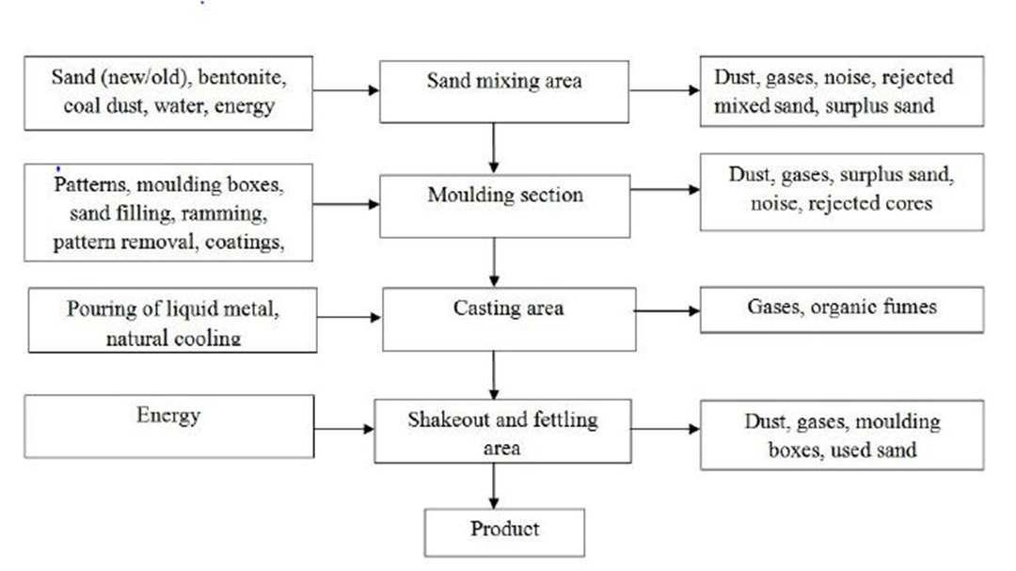
Cont..

Slide 15
Materials inputs and potential pollutant outputs for foundry
1 Pattern Making
In pattern making process, material inputs may be wood, plastic, metal, wax, polystyrene
Pollutants outputs given below.
Air Emissions:
VOC (Volatile Organic Compound) from glues, epoxies, and paints.
Waste water: Little or no wastewater generated but there is no plan for water utilization.
Residual Wastes: Scrap pattern materials

Slide 16
Cont..
2 Mold and Core Preparation and Pouring
In this process, materials inputs may be sand and chemical binders and pollutants outputs
Air Emissions:
Particulates, metal oxide fumes, carbon monoxide, hydrogen sulfide, sulfur dioxide, and nitrous oxide.
Also, Benzene, phenols, and other hazardous air pollutants
Wastewater:
Wastewater containing metals, elevated temperature, phenols and other organics from wet dust collection systems and mold cooling water
Residual Wastes:
Waste mold and core sand potentially containing metals and residual chemical binders

Slide 17
Cont..
3 Charging and Melting
In charging and melting process, material inputs may be metal scrap, ingot and returned
castings and pollutant outputs given below.
Air Emissions:
Products of combustion, oil vapors, particulates, metallic oxide fumes
Wastewater:
Scrubber wastewater with high pH, slag cooling water with metals, and non- contact cooling water
Residual Wastes:
Spent refractory material potentially containing metals and alloys

Slide 18
Cont..
4 Pouring
In this process, material inputs ladles and refractory materials and pollutant outputs given below.
Air Emissions:
Particulates, metallic oxide fumes
Wastewater:
Little or no wastewater generated
Residual Wastes:
Spent ladles and refractory materials potentially containing metals

Slide 19
Cont..
5 Shakeout, Cooling and Sand Handling
In this process, material inputs may be water and caustic for wet scrubbers and pollutant
output given below.
Air Emissions:
Dust and metallic particulates; VOC and organic compounds from thermal sand treatment
systems.
Wastewater:
Wet scrubber wastewater with high or low pH or amines, permanent mold contact cooling water
with elevated temperature, metals and mold coating
Residual Wastes:
Waste foundry sand and dust from collection systems, metal

Slide 20
Cont..
6 Felting
In this process, material inputs may be unfinished castings, water, steel shot, and solvents.
Pollutant outputs given below.
Air Emissions:
VOCs, dust and metallic particulates
Wastewater:
Waste cleaning and cooling water with elevated temperature, solvents, oil and grease, and
Suspended solids
Residual Wastes:
Spent solvents, steel shot, metallic particulates, cutting wheels, metallic filings, dust from
collection systems, and wastewater treatment sludge.

Slide 21
Survey
In India there are more than 5000 foundries
There are many hubs of foundries like West Bengal, Gujarat, Maharashtra, Tamilnadu, Karnataka, Andra Pradesh and Jharkhand.
Ahmadabad, located in the state of Gujarat, is an important foundry cluster in Western India
There are about 600 foundry units in Gujarat.
The cluster came-up mainly to cater to the casting requirements of the local diesel engine industry
To have true picture of these hubs, foundries from Ahmadabad were chosen for study of investigation of wastes

Slide 22
Experimental result of solid waste
Sr. No. | Waste | Concentration in mg/kg
 |  | cu |  |  | zn |  |  | Pb |  |  | Ni
 |  | F1 | F2 | F3 | F1 | F2 | F3 | F1 | F2 | F3 | F1 | F2 | F3
1 | Sand waste | 220 | 190 | 182 | 79 | 71 | 67 | 172 | 180 | 158 | 125 | 130 | 118
2 | Dust | 166 | 143 | 151 | 169 | 138 | 149 | 263 | 255 | 248 | 206 | 199 | 224
3 | Slag waste | 520 | 482 | 543 | 306 | 297 | 319 | 49 | 52 | 57 | 484 | 490 | 503
4 | Waste From Ladle | 141 | 130 | 150 | 340 | 312 | 302 | 30 | 26 | 23 | 239 | 227 | 244

Slide 23
Conclusion of survey
From table following conclusion can be made
The foundries generate lot of Solid waste like sand waste, dust, and slag waste, waste from ladle which is harmful for human health. There is no arrangement for beneficial reuse, disposal, treatment and handling
Regarding air emission, Small and medium size foundries from Ahmadabad hub are emitting pollutants from different department namely Furnace operation, Preparation of cores and molds, Casting, Shakeout and reclamation.

Slide 24
Scope of survey
There is a tremendous scope for these foundries to use the high quality raw material for reduce the harmful materials and particulars in the air and the devices like Filters, Cyclones separators, Mechanical Collectors, Scrubbers to enhance the awareness in relation with cleaner production idea
There is a lack of economical information for many recent techniques.
There is need of awareness with this regard towards moving for sustainable development.

Slide 25

Methodology
Generally different models are available for the calculation of Venturi particle collection efficiency.
Johnstone equation, Infinite throat mode, Cut power method, Contact power theory, Pressure drop.
Johnstone’ method
One of the more popular and widely used collection efficiency equations is that

Slide 26

Cont..
η =is the collection efficiency,
K_{p} = is the inertial impaction parameter (dimensionless),
R= liquid-to-gas ratio
k =the correlation coefficient,
The inertial impaction parameter (Kp) given by Equation
where dp =the particle diameter (ft),
ρ_{p} = the particle density (lb/ft3),
V_{t}=the throat velocity (ft/s),
μ_{G}= the gas viscosity (lb/ft-s
=the mean droplet diameter (ft) and
C = the Cunningham correction factor(dimensionless).

Slide 27
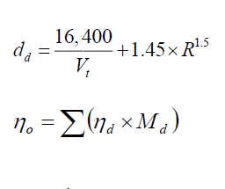
Cont..
The mean droplet diameter (d_{d}) for standard air and water in a venturi scrubber is given by the Nukiyama-Tanasawa relationship, shown in Equation .
The overall collection efficiency of the system can be calculated using Equation
where M_{d} is the weight percent of the particles of a given diameter.

Slide 28
Cont..
How the parameters affects on venturi scrubber
efficiency by using ANSYS Software

Slide 29
About Company
EG Tech corporation:
EG Tech has been managing POSCO's Acid Recycling Facility
They are make Iron Oxide(Fe2O3) powder

Slide 30
REFERENCE
[1] Azzopardi B.J. and A.H. Govan (1984), ‘The modeling of Venturi scrubbers’ Filtration and Separation, Vol. 23, pp. 196-200.
[2] Azzopardi B.J., S.F.C.F. Teixeira, A.H. Govan and T.R. Bott (1991) ‘An improved model for pressure drop in Venturi scrubbers’, Transactions of the Institute of Chemical Engineers, B69, pp. 55–64.
[3] Boll R.H. (1973) ‘Particle collection and pressure drop in Venturi scrubbers’ Industrial & Engineering Chemistry Fundamentals, Vol. 12(1), 40-50.
[4] Calvert S., (1970) ‘Venturi and other atomizing scrubbers efficiency and pressure drop’, AIChE Journal, Vol. 16, pp. 392-396.
[5] Calvert S., D. Lundgren and D.S. Mehta (1972) ‘Venturi scrubber performance’ Journal of Air Pollution Control Association, Vol. 22, pp. 529-532.

Slide 31
REFERENCE
[6] Charisiou N.D., G. Tsevrenis, M.A. Goula (2011) ‘Software development for the design of control equipment for particulate pollutants’, Proc. Int. Conf. on Environmental Science and Technology VII, pp. A295-A302.
[7] Goncalves J.A.S., D. Fernandez Alonso, M.A. Martins Costa, B.J. Azzopardi and J.R. Coury (2001) ‘Evaluation of the models available for the prediction of pressure drop in Venturi scrubbers’ Journal of Hazardous Materials, Vol. B81, pp. 123-140.
[8] Goncalves J.A.S., M.A.M. Costa, M.L. Aguiar and J.R. Coury (2004) ‘Atomizatin of liquids in a Pease–Anthony Venturi scrubber. Part II. Droplet dispersion’ Journal of Materials, Vol. 116, pp. 147-157.
[9] Cooper C.D. and F.C. Alley (2004) ‘Air pollution control: A design approach’ Waveland Press, Inc.
[10] Johnstone H.F., R.B. Feild and M.C. Tassler (1954) ‘Gas absorption and aerosol collection in a Venturi atomizer’, Industrial and Engineering Chemistry, Vol. 46, pp. 1601-1608.

Slide 32
THANK YOU…

